Slide 1
(How to) Talk a-Bot the MS Bot Framework
Justine Cocchi
@justinecocchi

Slide 2
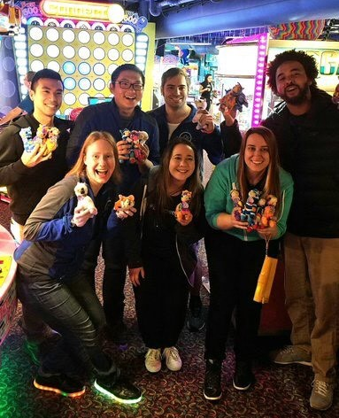
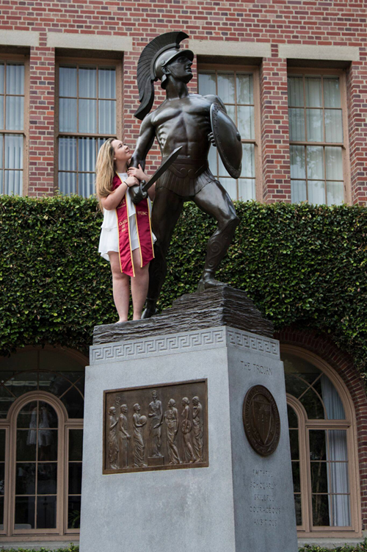

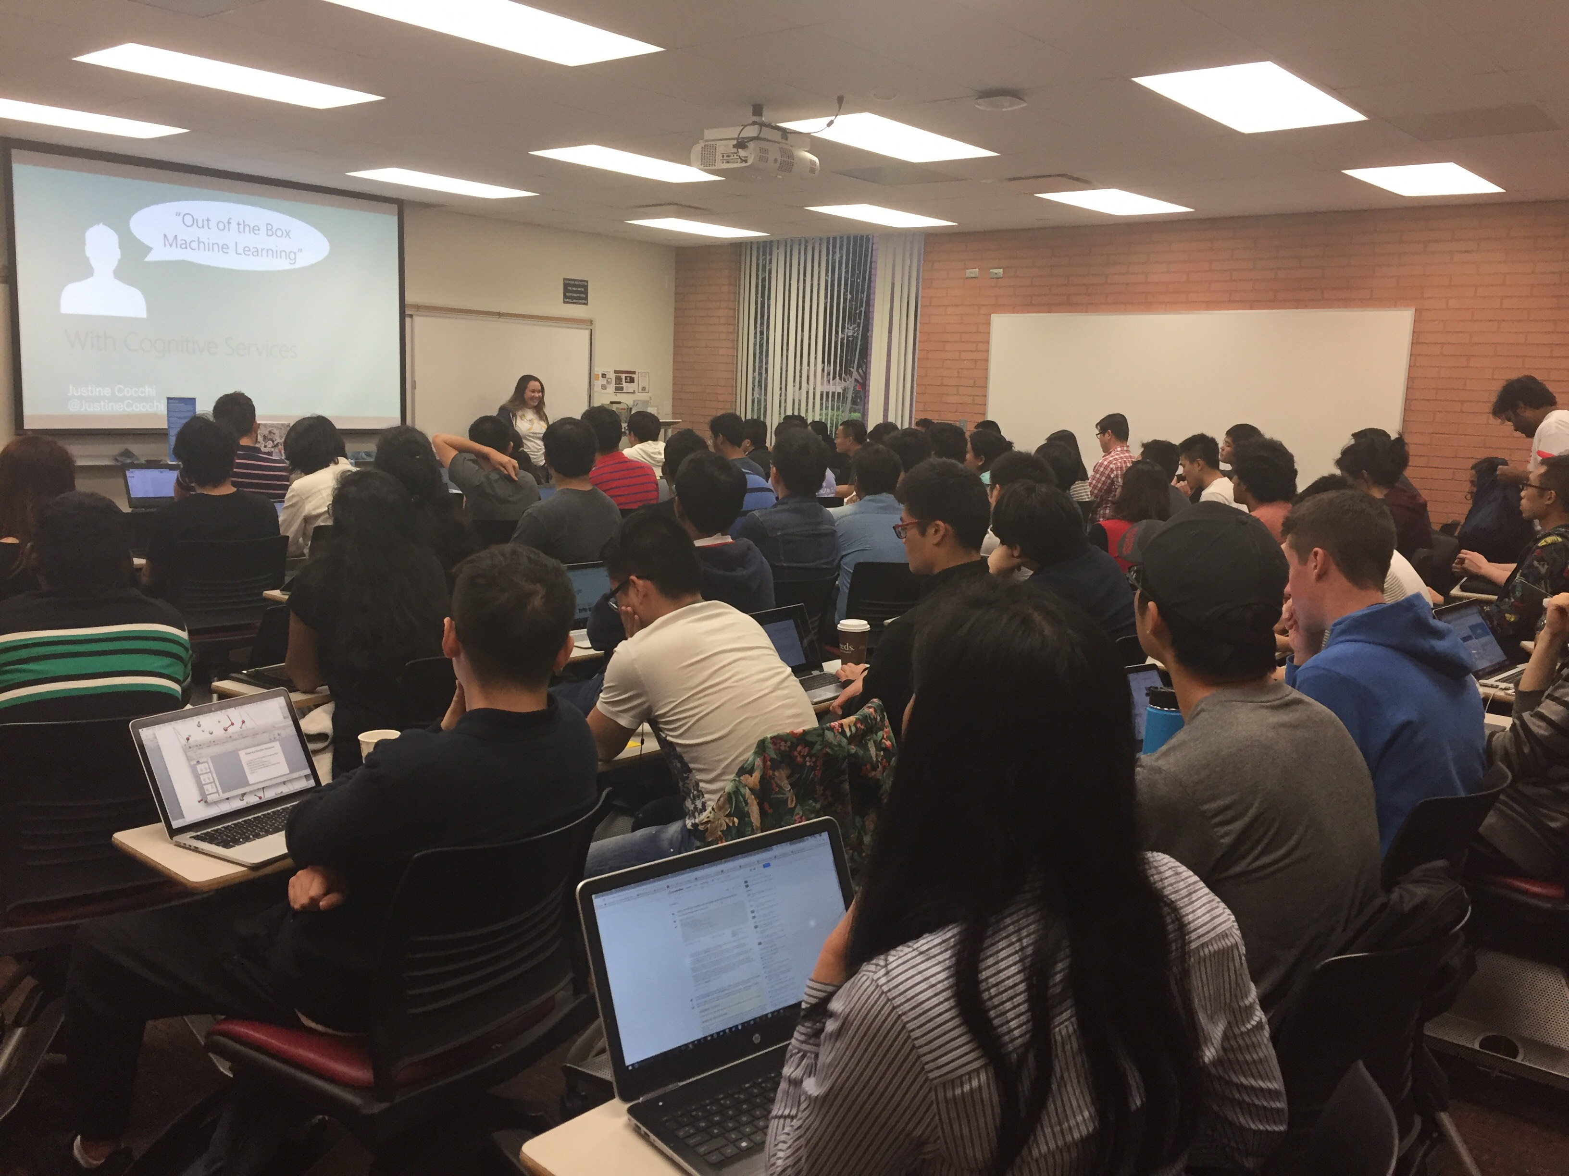
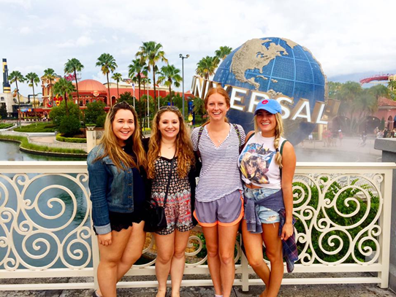
About Justine
B.S. Computer Science and Business Administration from USC
Microsoft for one year
Bike rides, comedy shows, and Netflix

Slide 3
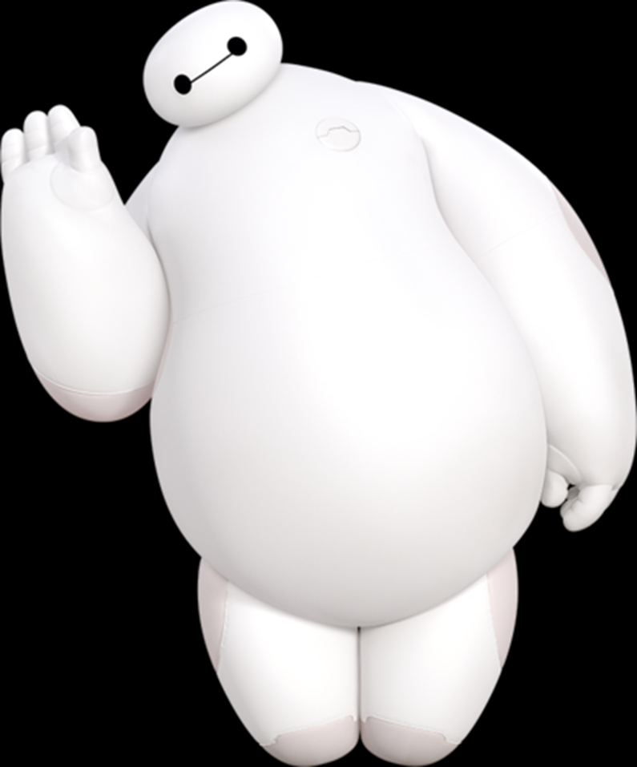
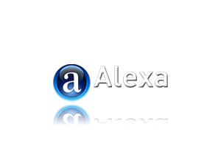
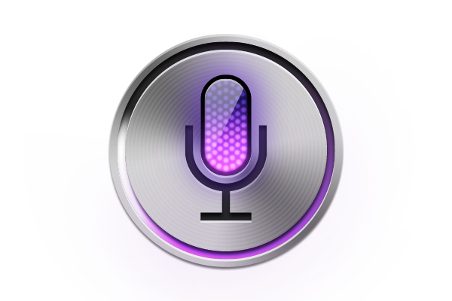
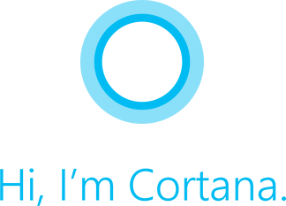
What are Bots?

Slide 4
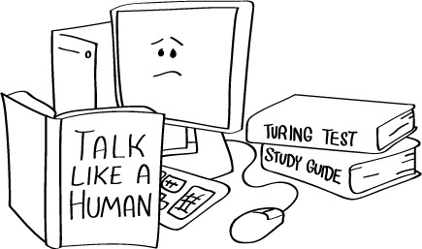
“I will know I built a good bot when it passes the Turing Test”

Slide 5
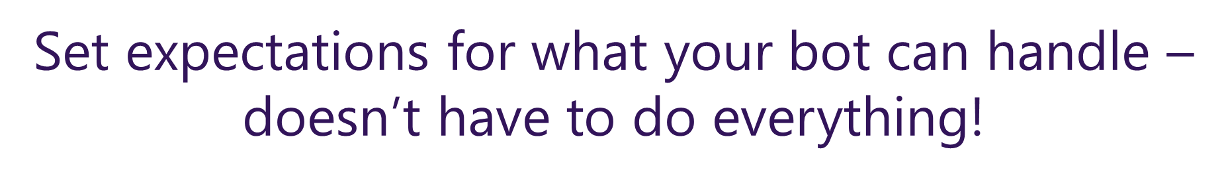
Bots are Apps Conversation as a Platform (CaaP)
Information Focused
Knowledge base
Question and answer
Action Focused
Task automation
Bot to human handoff

Slide 6

Murphy Bot

Slide 7
Microsoft Bot Framework

Slide 8
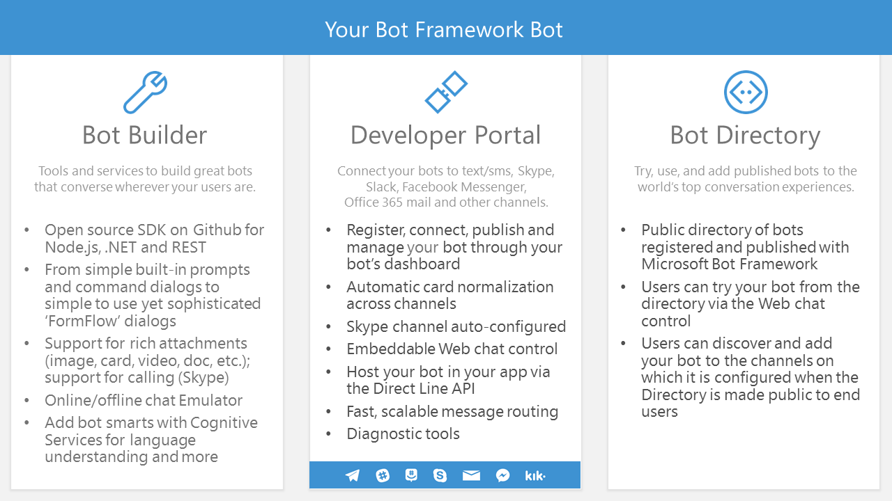

Slide 9
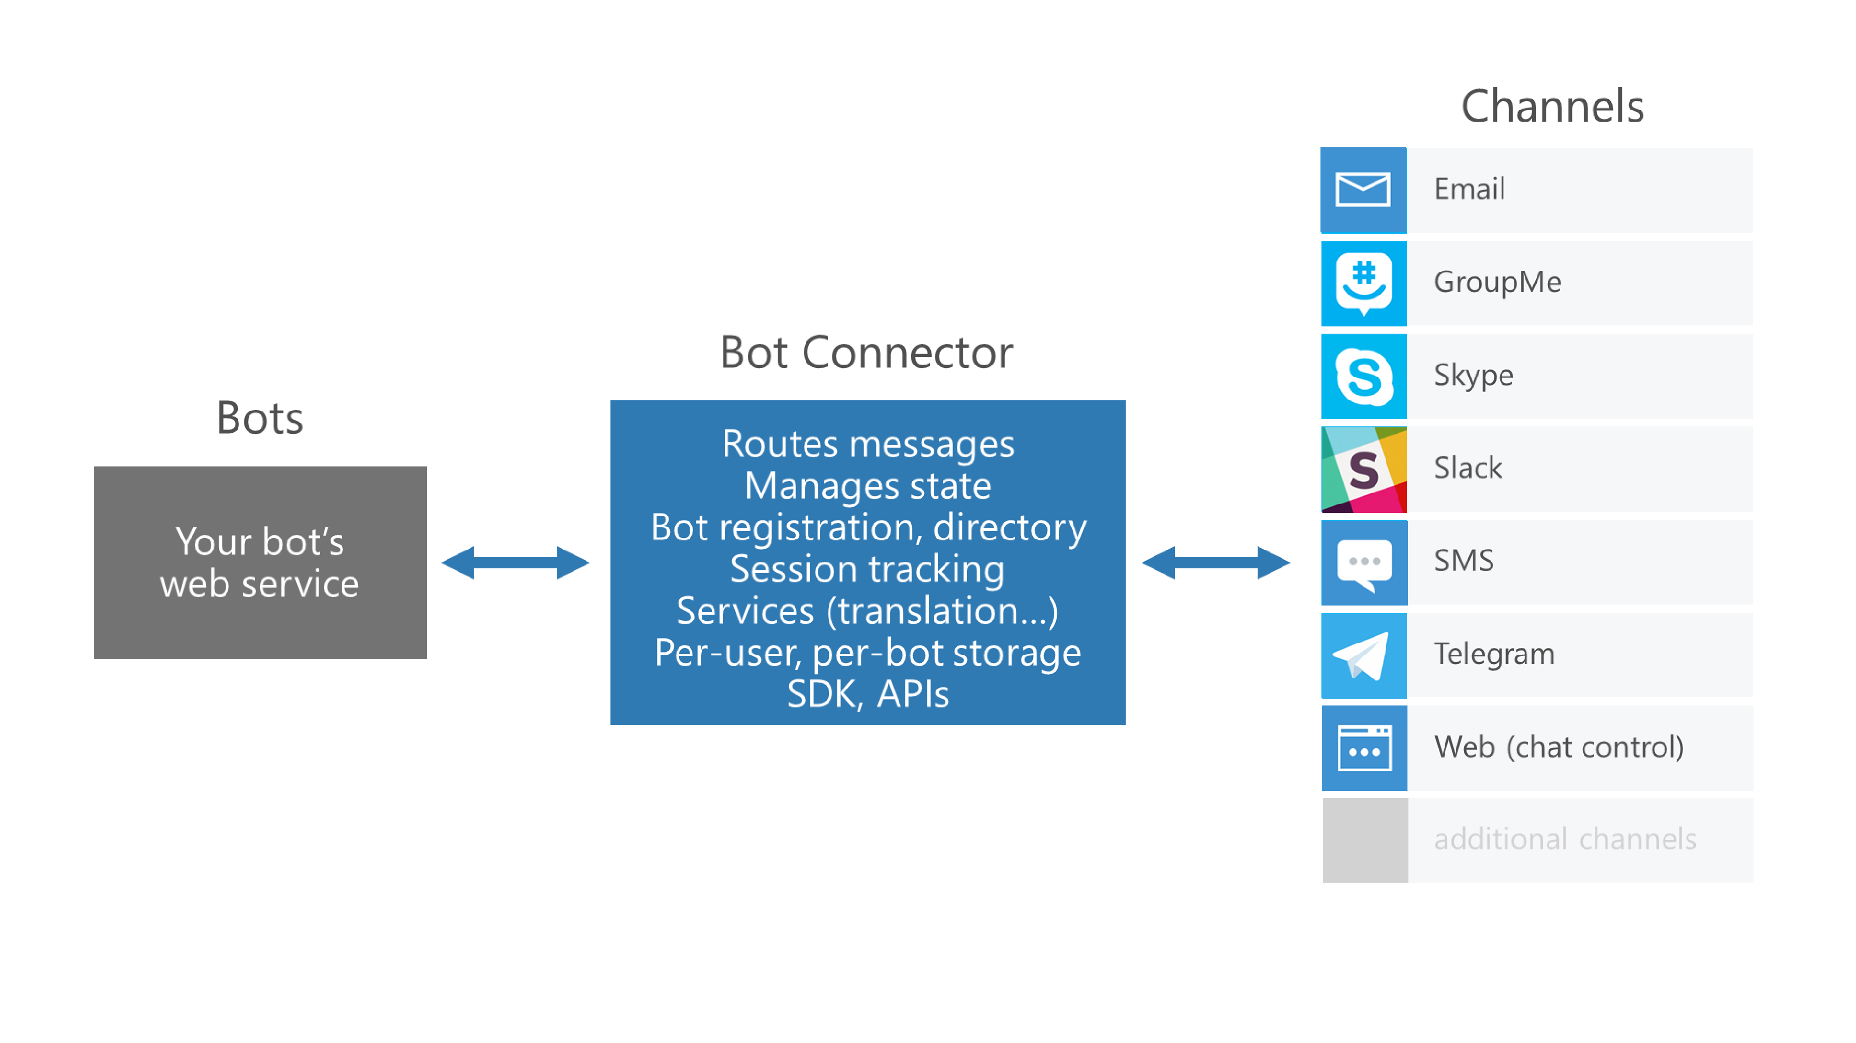
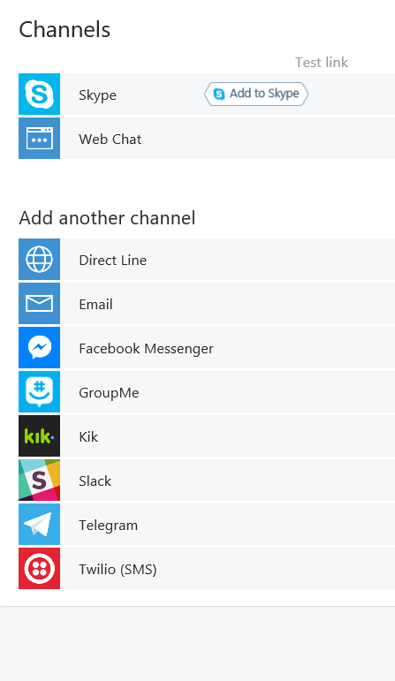

Slide 10
Let’s build a bot

Slide 11
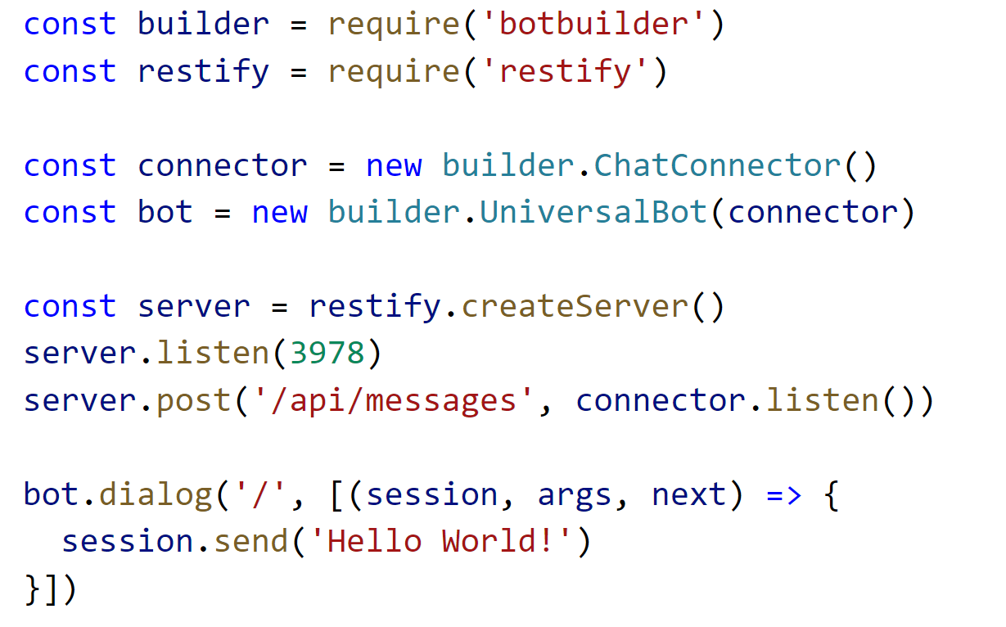
Hello World Bot

Slide 12
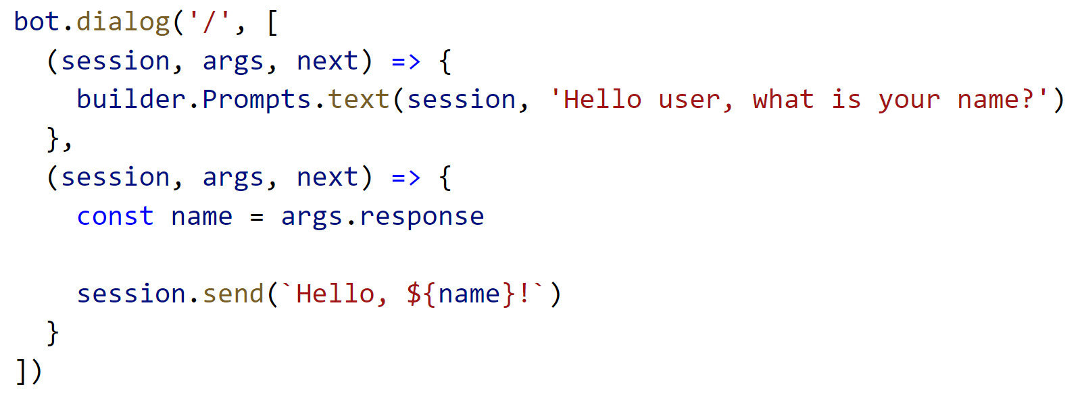
Using Prompts

Slide 13
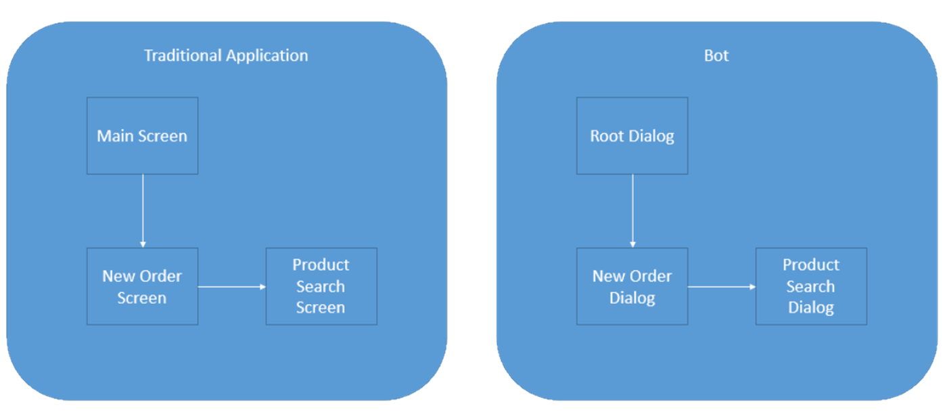
Bot design is app design
Screens become dialogs organized into a “stack”

Slide 14
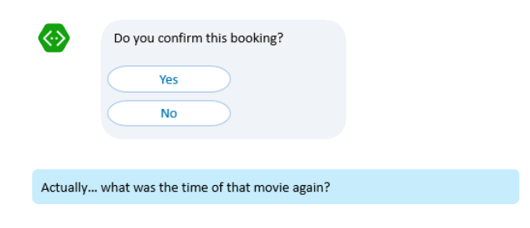
But users don’t think in stacks...
…so now what?

Slide 15
Navigating the dialog stack
Begin Dialog
Add a new dialog to the top of stack
End Dialog
End the current dialog and return to the next one on the stack
Replace Dialog
Remove the top dialog from the stack & replace it with a different one
Cancel Dialog
Cancel the first occurrence of a specific dialog in the stack

Slide 16
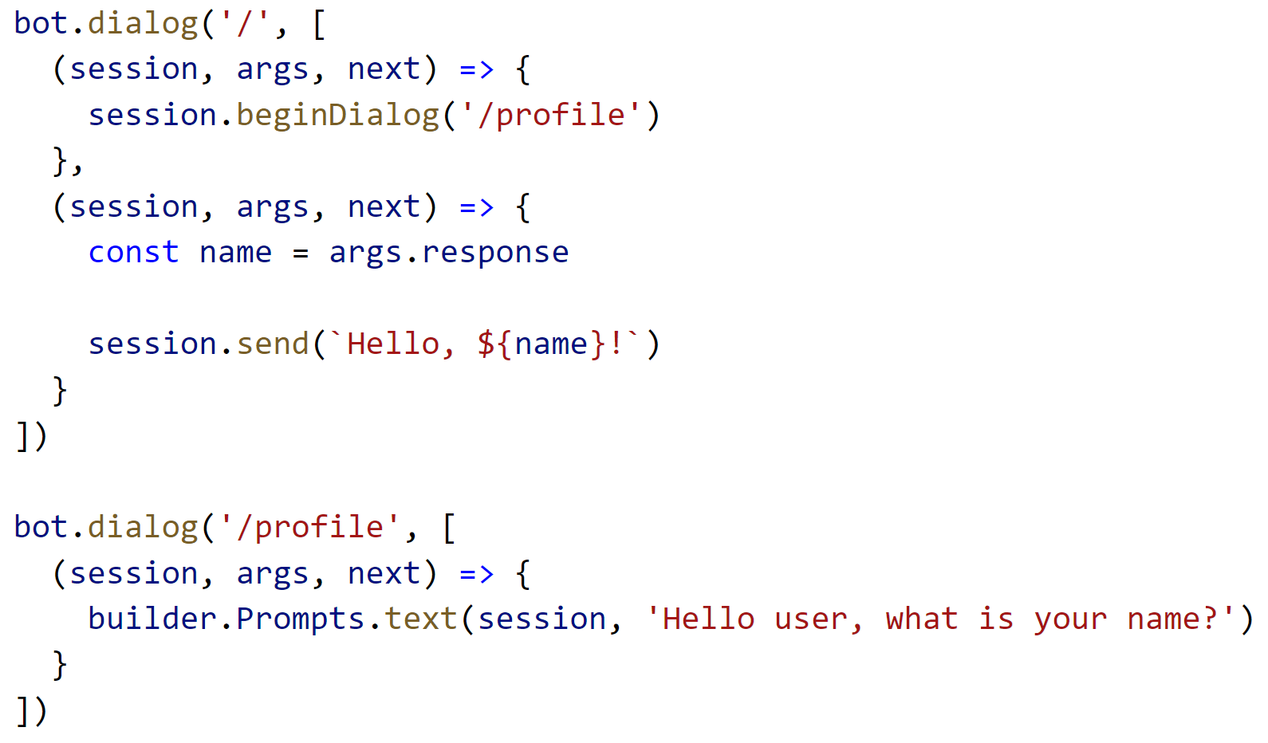
Navigating the Dialog Stack

Slide 17
Persisting Data
Think about scope
Dialog level
Conversation level
User level
Application level

Slide 18
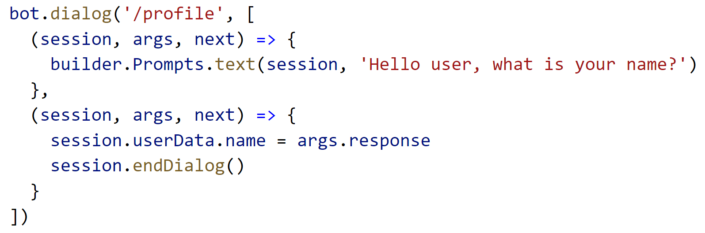
Persisting Data

Slide 19
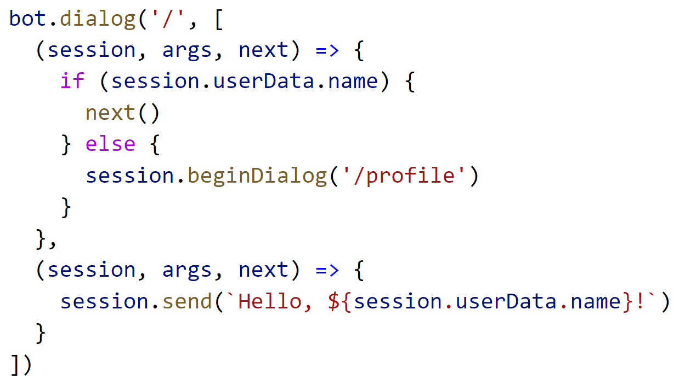
Persisting Data

Slide 20
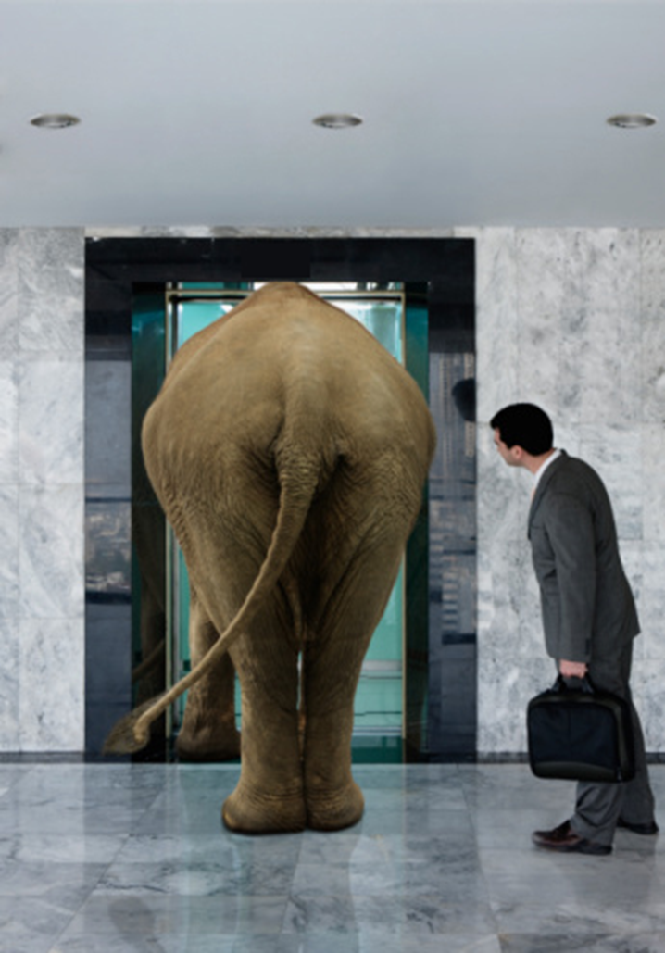

Slide 21

Why do users hate bots today?

Slide 22
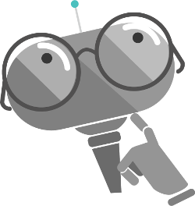
What makes a bot seem smart?

Slide 23
Language Understanding Intelligent Service (LUIS.ai)
Lets you understand what your users are saying
A few examples are enough to deploy an application
LUIS learns over time
Define
Concepts
Provide
Examples
Active Learning
Deploy

Slide 24
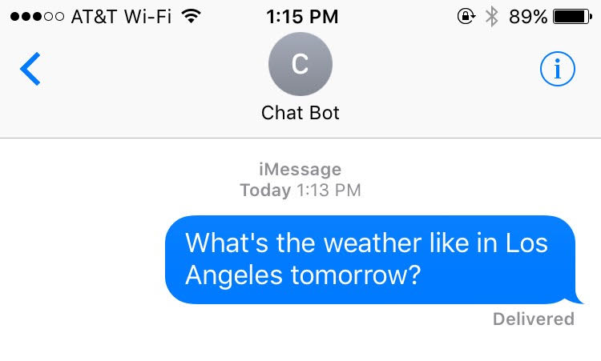
Intents, entities, and utterances
public void getWeather(string loc, DateTime date)
{
// Do Something
}

Slide 25
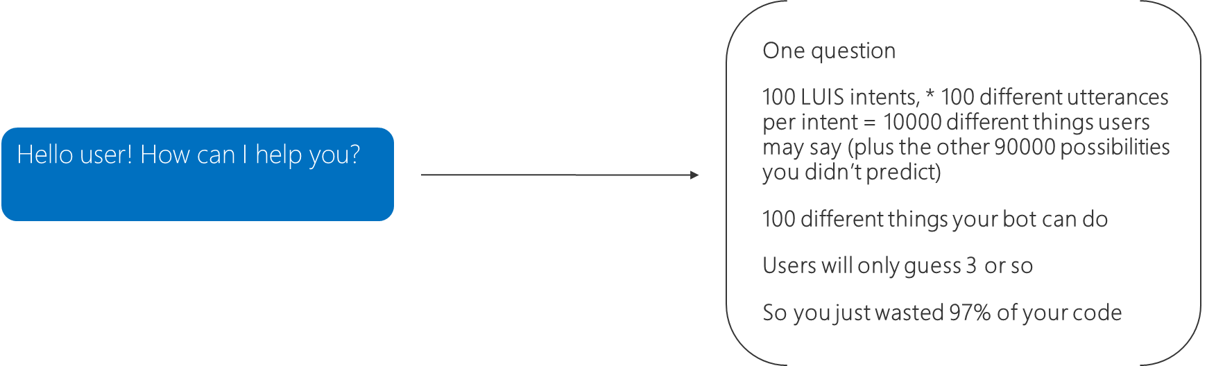
What makes a bot seem smart?
Natural Language Processing

Slide 26
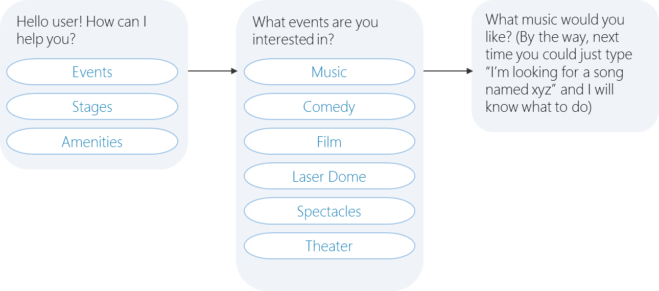
What makes a bot seem smart?
Natural Language Processing
Instead, help the user discover what your bot can do

Slide 27
What really makes a bot seem smart?

Slide 28
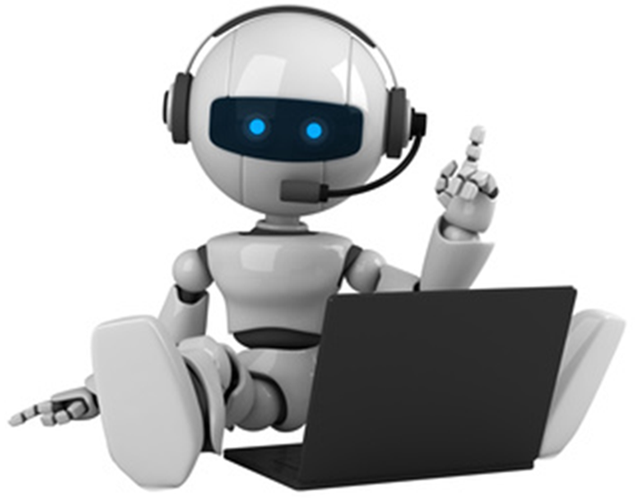
User experience
Solve the user’s problems better than the alternative
More natural interface for apps and websites
Available on multiple platforms
Meet the user where they already are (Slack, SMS, FB Messenger)
vs.
Downloading something new

Slide 29
Additional Resources
Documentation → Docs.Microsoft.com/Bot-Framework
QnA Maker → QnAMaker.ai
LUIS → luis.ai
Sample Bots → Github.com/Microsoft/BotBuilder-Samples
Sample Workshop → Github.com/MSFTImagine/computerscience
This Presentation → Github.com/jcocchi/BotWorkshop

